Slide 1


LEARNLANCE
RESS PROJECT
Submitted To:
MR. UBAID AFTAB CHAWLA

Slide 2
DISCLAIMER
“This presentation is intended to offer a comprehensive overview of the submitted Software Requirements Specification (SRS). Please note that this PowerPoint may lack diagrams, charts, and other detailed requirements, as its primary purpose is to provide a high-level summary. For a more in-depth analysis and access to all charts and diagrams, we recommend referring to the detailed SRS document.”
“In the SRS, we have meticulously crafted and analyzed every chart, diagram, and written requirement for thorough understanding and reference.”

Slide 3



Our Team
Insha Samnani
Yusra Adam
Ismail Ansari
20K-0247
20K-0207
20K-0228

Slide 4
INTRODUCTION

Slide 5
Scope
The LearnLance platform represents a self-contained and innovative solution for online learning and teaching, with the integration of freelancing elements. Traditional education systems often lack the flexibility and personalization required for effective learning, while traditional freelancing platforms may lack the structured educational environment necessary for skill development. LearnLance addresses this critical gap by offering a versatile and interconnected learning ecosystem, enabling personalized learning, peer-to-peer collaboration, and skill development in an integrated manner. LearnLance is driven by the pressing need to revolutionize the educational experience, combining the best elements of online learning, and freelancing to create a holistic and connected environment.
For detailed Scope, please refer to the SRS

Slide 6
Vision
For students and teachers who are seeking a seamless, connected, and user-centric learning and teaching experience, the LearnLance is an internet-based and android mobile revolutionary application that caters for the diverse needs of students by providing webinars, topic-based learning, peer-to-peer collaboration, and community engagement and serves teachers by offering a platform to showcase their expertise, manage courses, conduct live sessions, and access a network of students seeking personalized learning. Unlike traditional learning and freelancing platforms, students and teachers who uses LearnLance no longer need to navigate multiple platforms and maintain separate profiles to access learning and teaching services; instead, it will offer a unified application that includes enhanced student-teacher interaction and improved personalized recommendations for topic request jobs and courses, revolutionizing the way students and teachers explore and engage with teaching and learning services, making the experience more efficient and user-centric

Slide 7
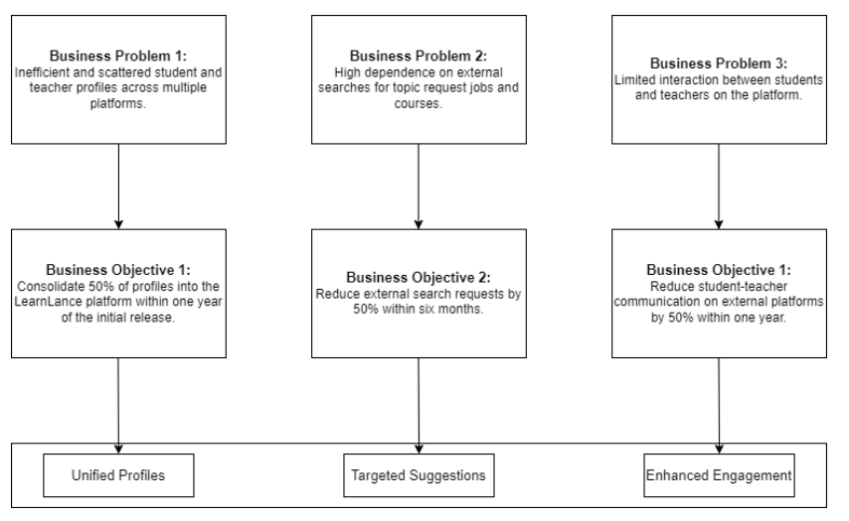
Business Objectives and Opportunities

Slide 8
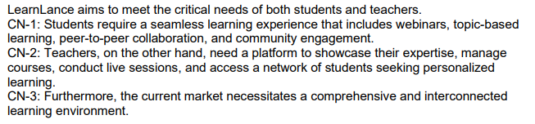
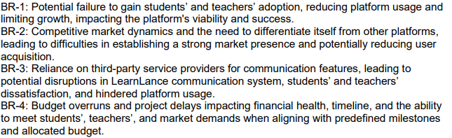
Customer Needs
Business Risks

Slide 9
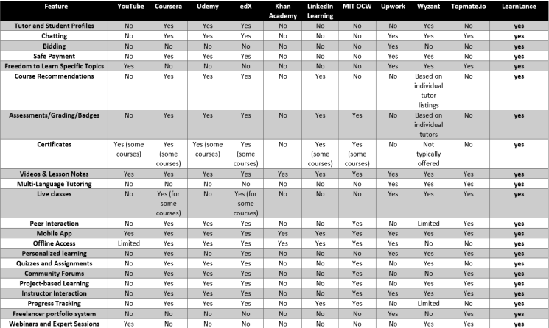
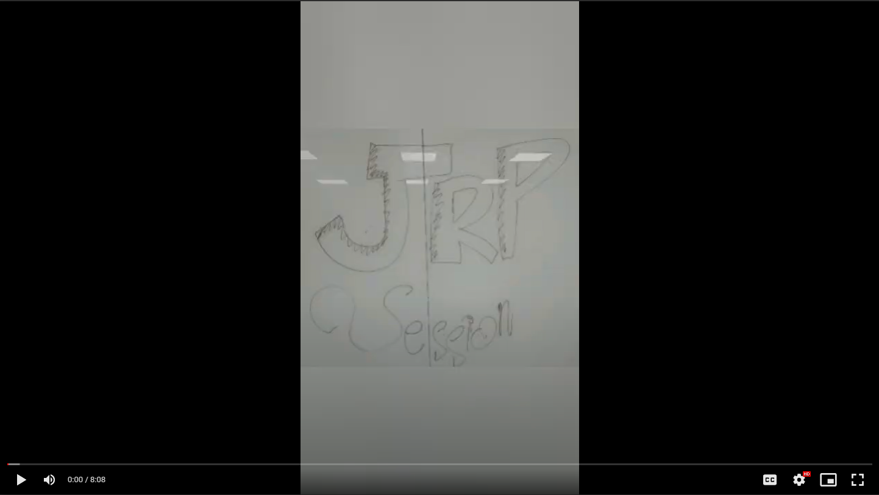
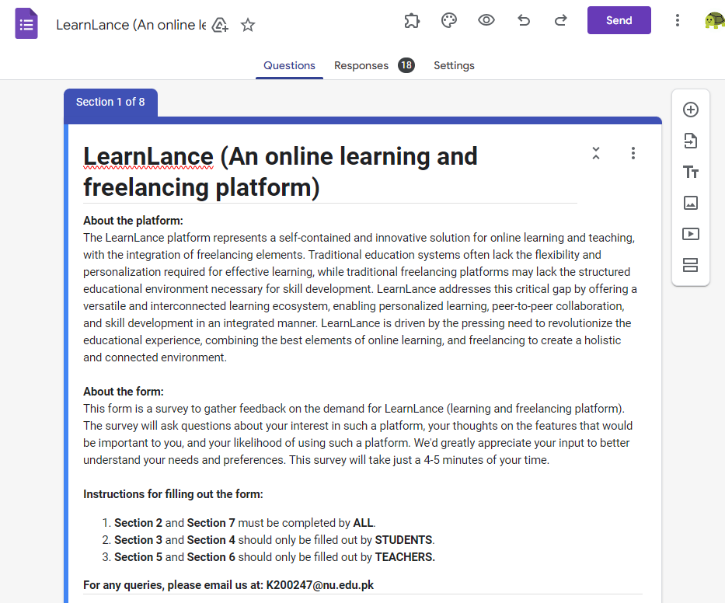
Research
JRP Session
Requirement Elicitation Techniques
Questionnaire

Slide 10
Product Perspective
LearnLance is a pioneering and self-contained online learning and freelancing platform that emerged in response to the challenges posed by the fragmented landscape of existing educational and freelancing platforms. Unlike current systems that lack cohesive integration, LearnLance is a standalone product designed to be a unified solution. It is not a replacement for existing systems but aims to redefine the user experience by seamlessly combining social networking, learning, and business elements within a single platform. LearnLance stands alone as a comprehensive solution, eliminating the need for users to navigate multiple platforms for educational and freelancing purposes. This system's perspective is self-contained, offering a unique space where students, educators, and freelancers can access a diverse range of educational services, job opportunities, and networking functionalities in an integrated manner. The platform's major components, subsystem interconnections, and external interfaces will be detailed to provide a clear understanding of its holistic structure and functionality in the larger digital ecosystem.

Slide 11
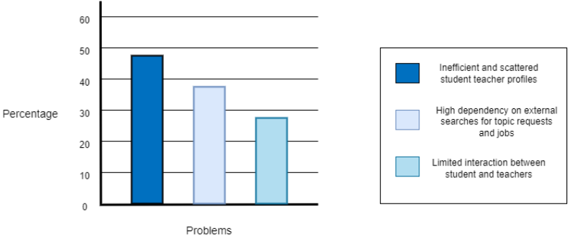
Problem Analysis
Pareto Bar Chart

Slide 12
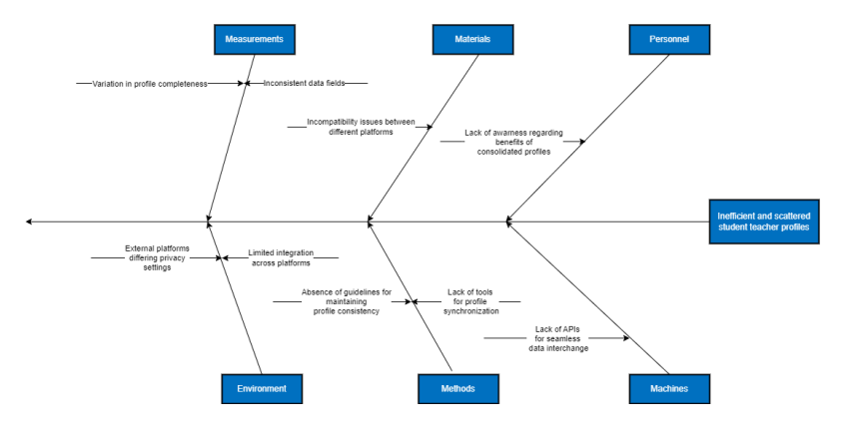
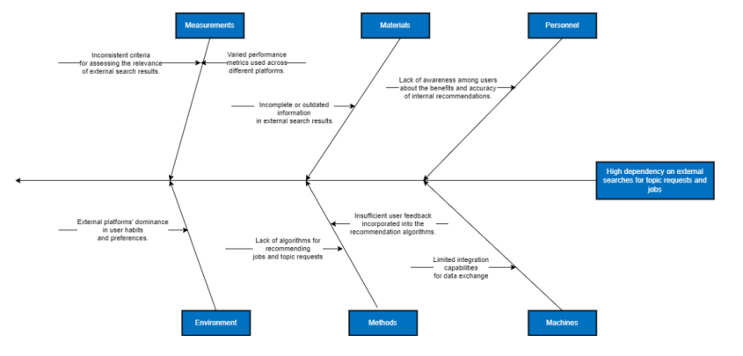
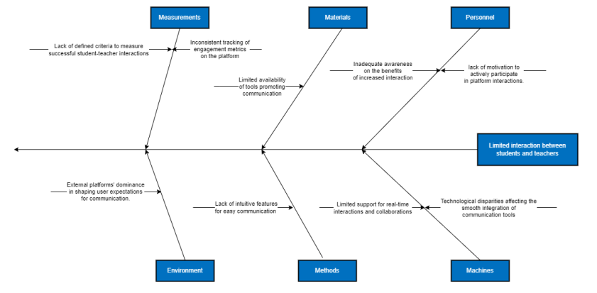
Problem Analysis
Ishikawa Diagrams

Slide 13
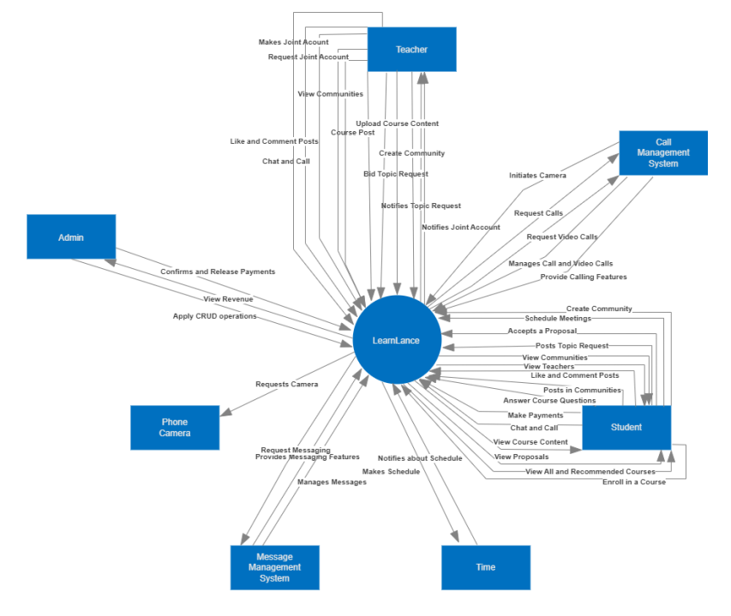
Context Diagram

Slide 14
OVERALL
DESCRIPTION

Slide 15
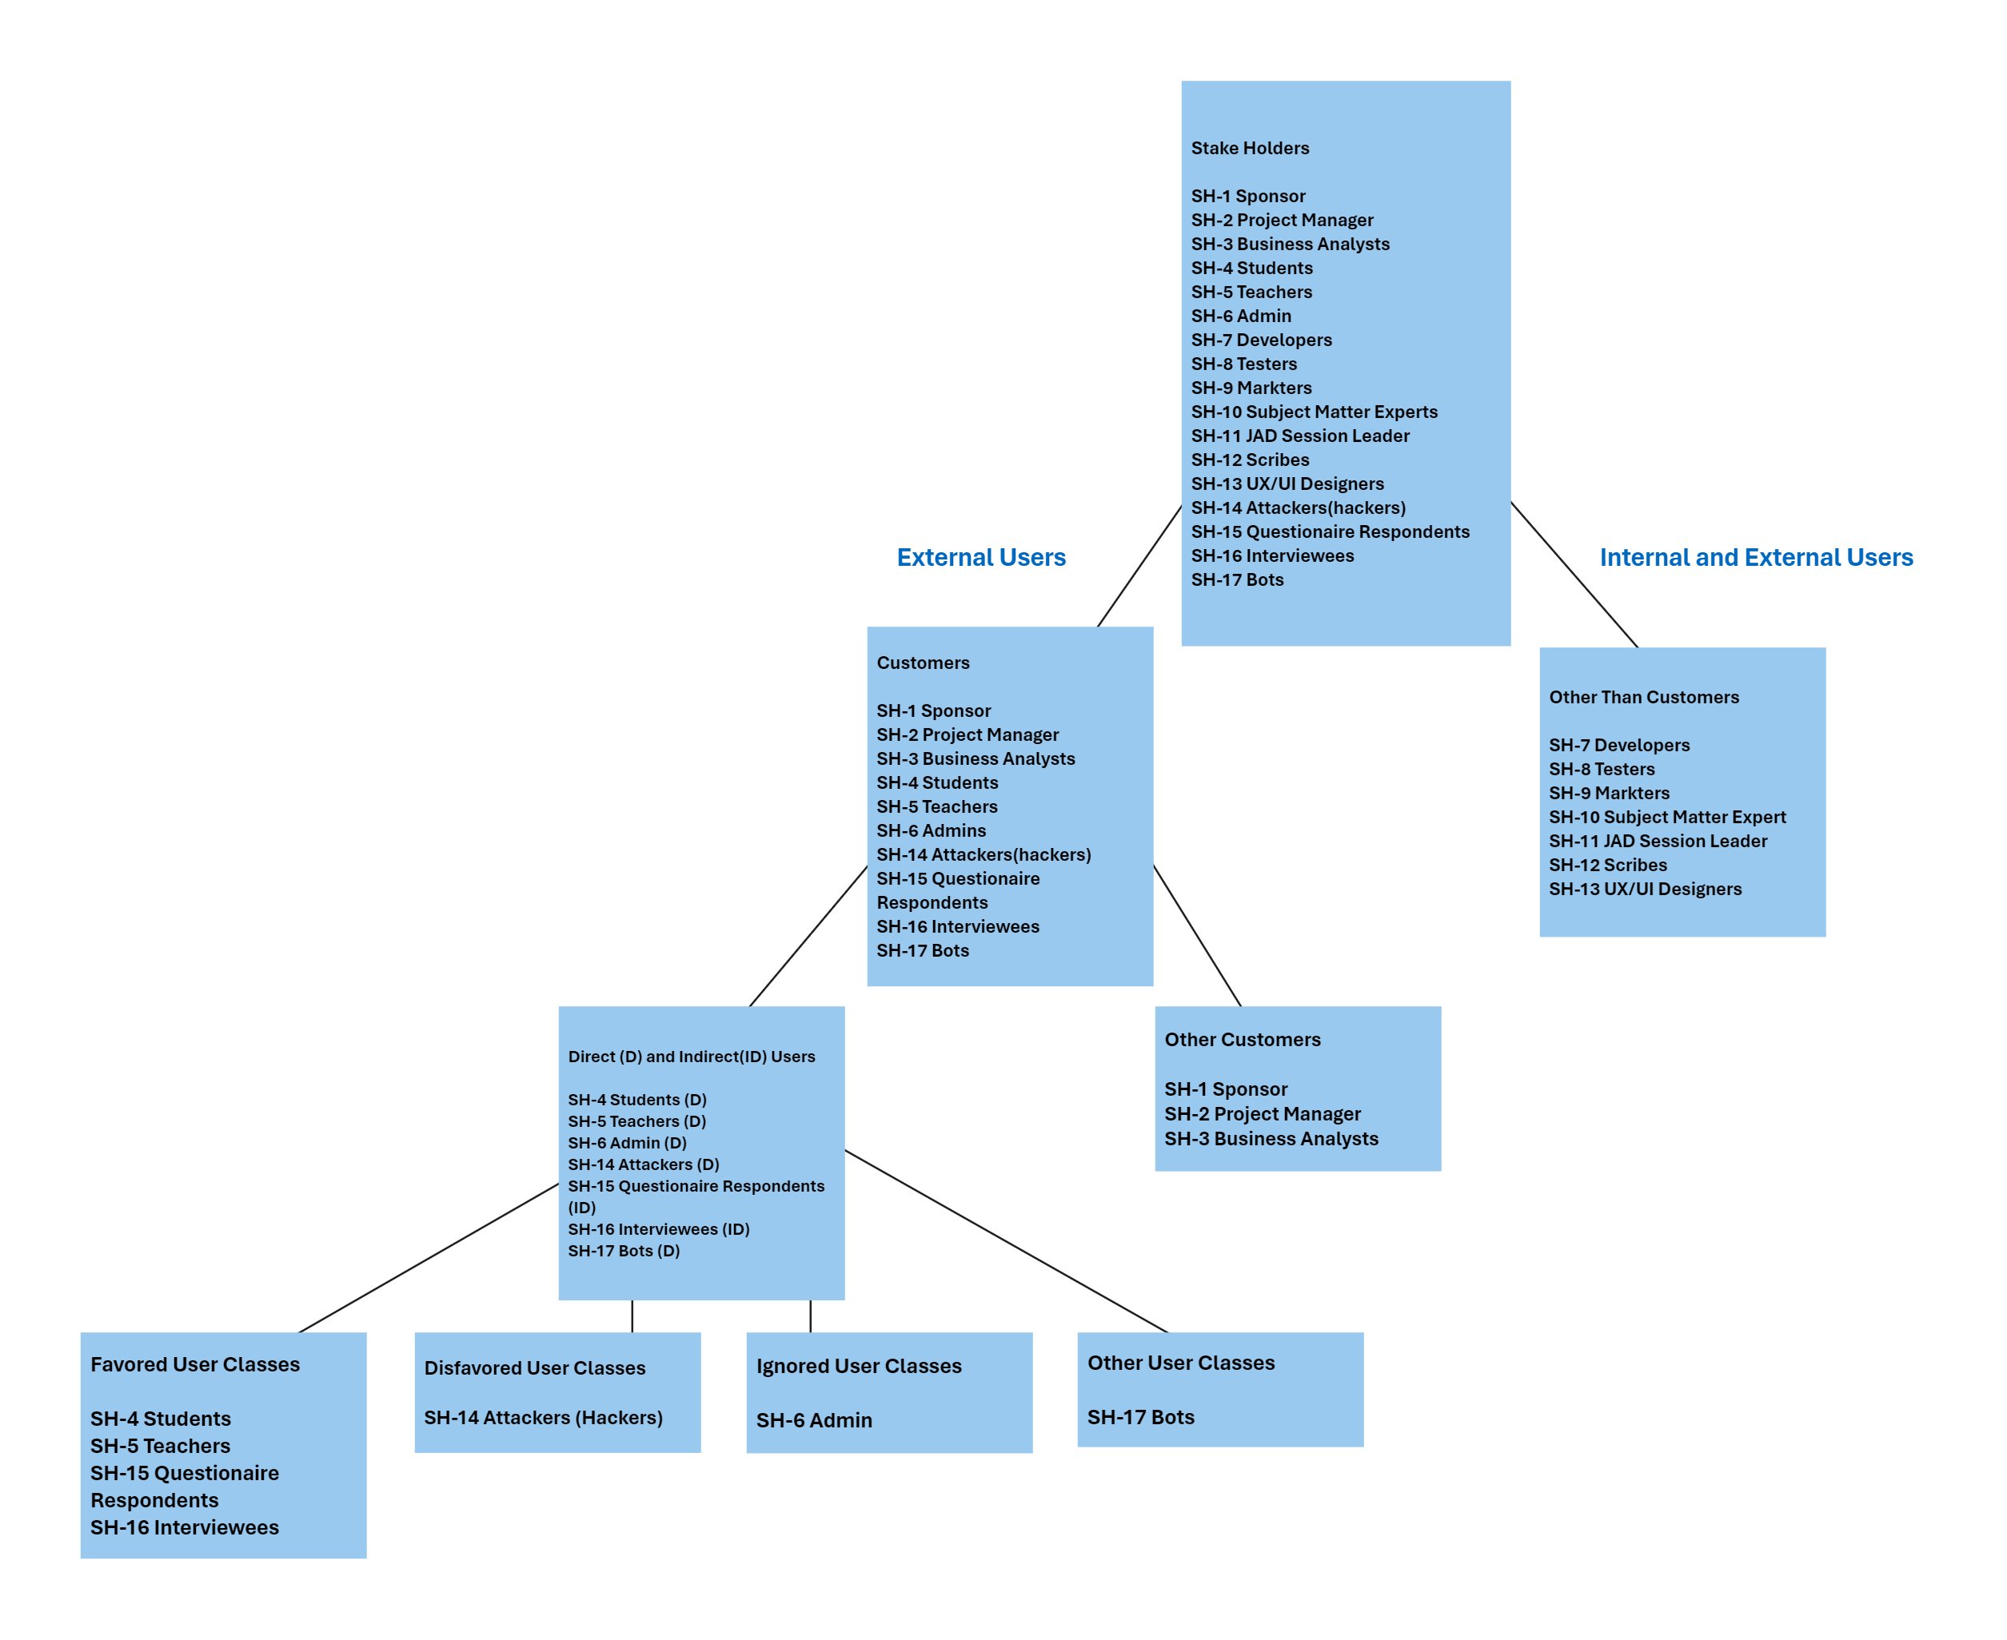
Stake
Holders

Slide 16
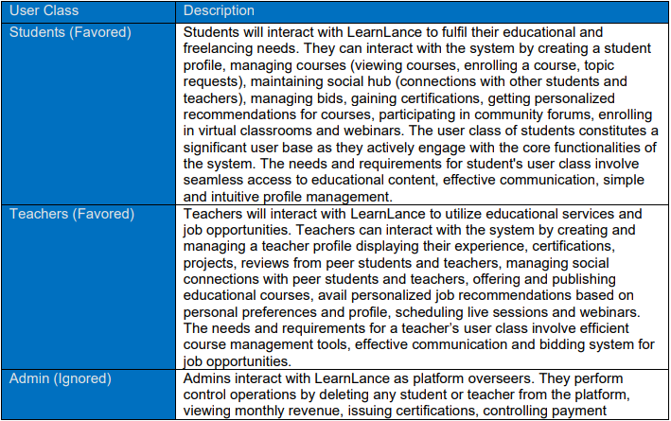
User
Classes

Slide 17
EXTERNAL INTERFACE REQUIREMENTS

Slide 18
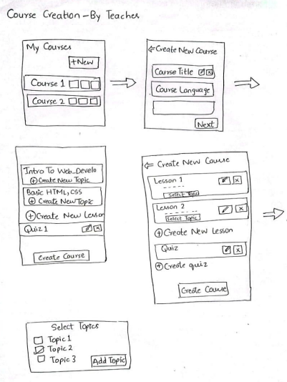
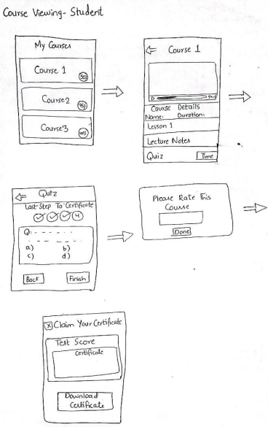
Story
Boards

Slide 19
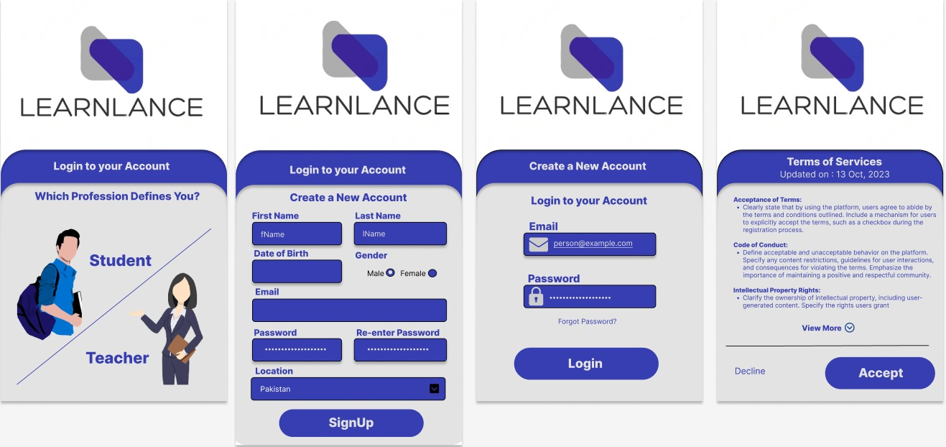
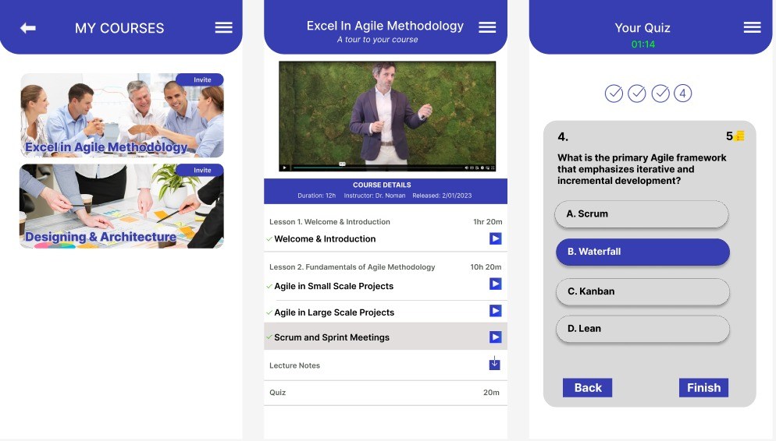
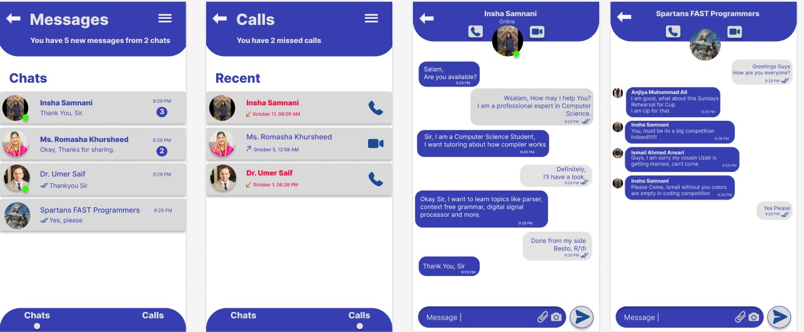
Prototypes

Slide 20
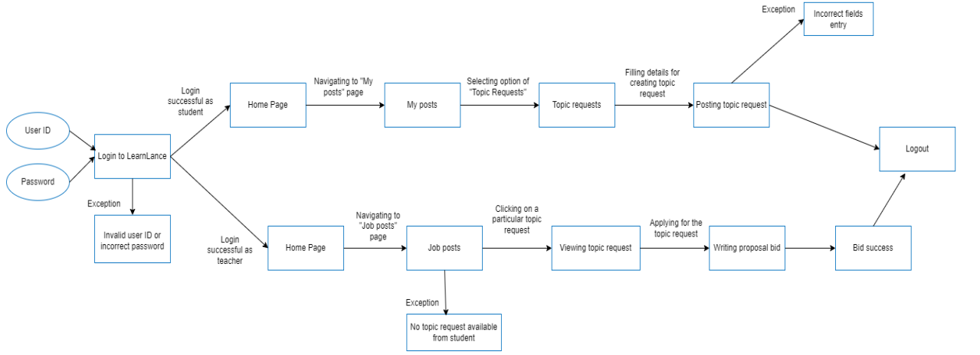
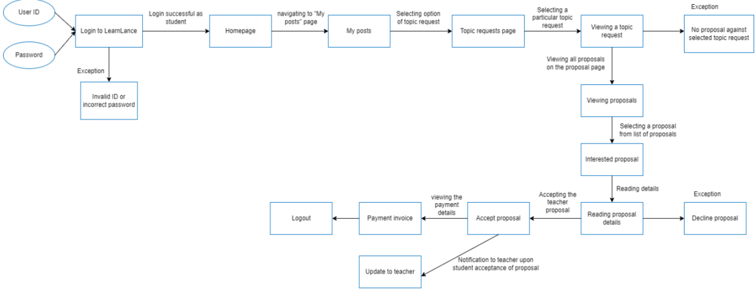
Scenarios

Slide 21
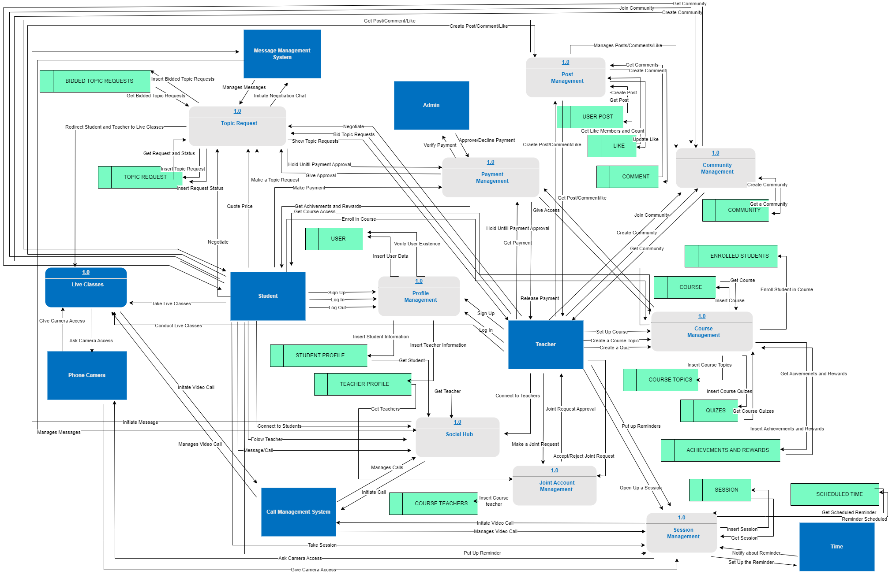
DFD

Slide 22
SYSTEM
FEATURES

Slide 23
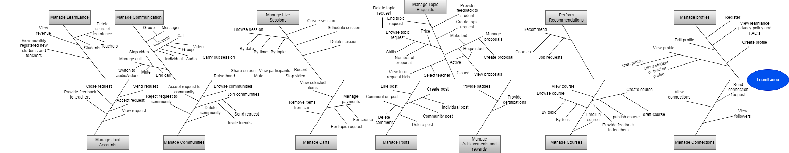
Feature
Tree

Slide 24
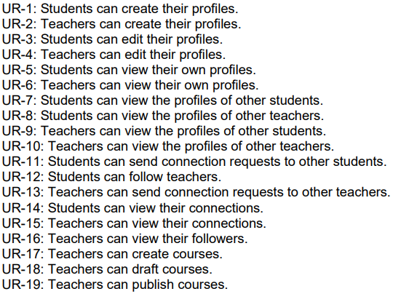
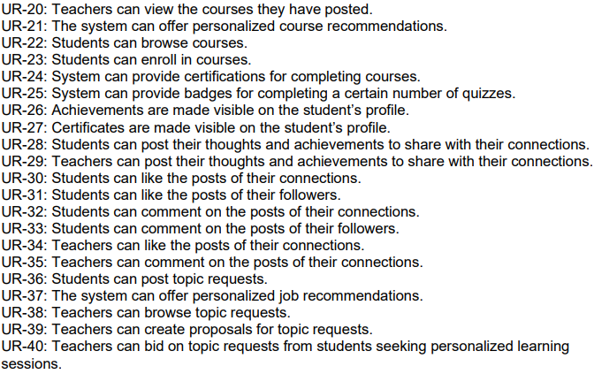
User Requirements

Slide 25
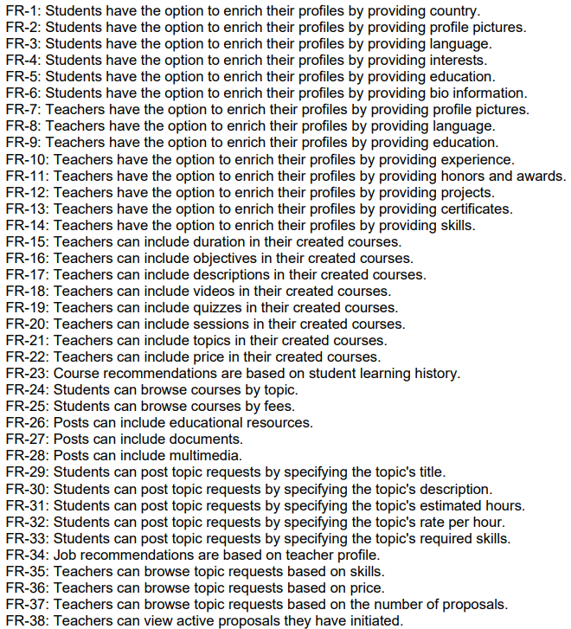
Functional Requirements

Slide 26
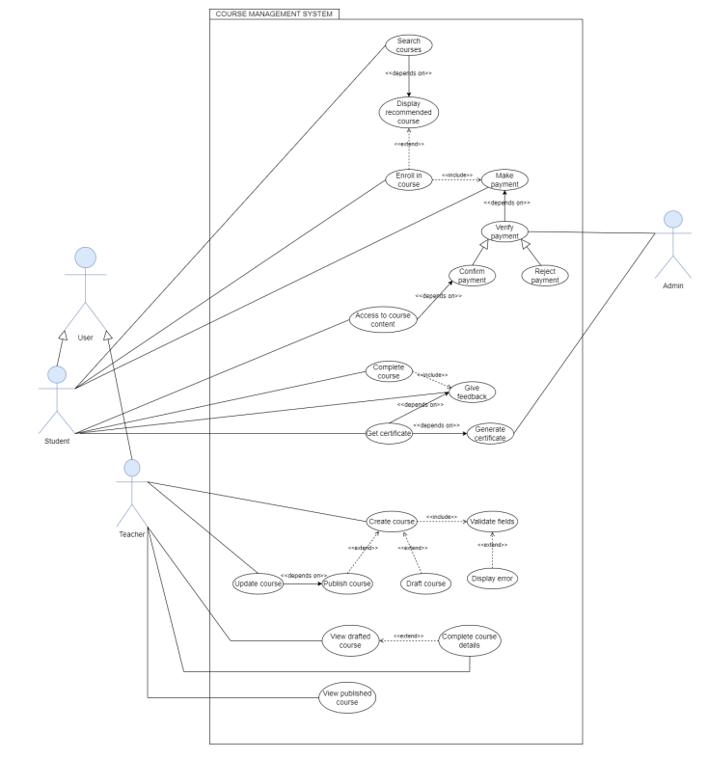
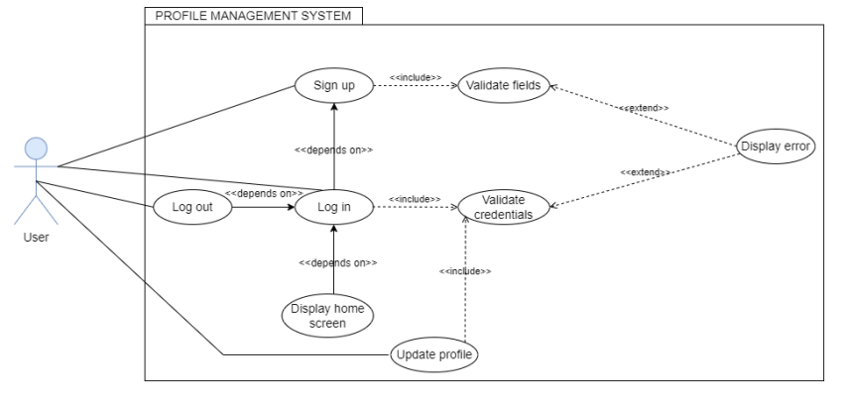
Use Case
For User Personas, Use Case Glossary, User Stories, please refer to the SRS

Slide 27
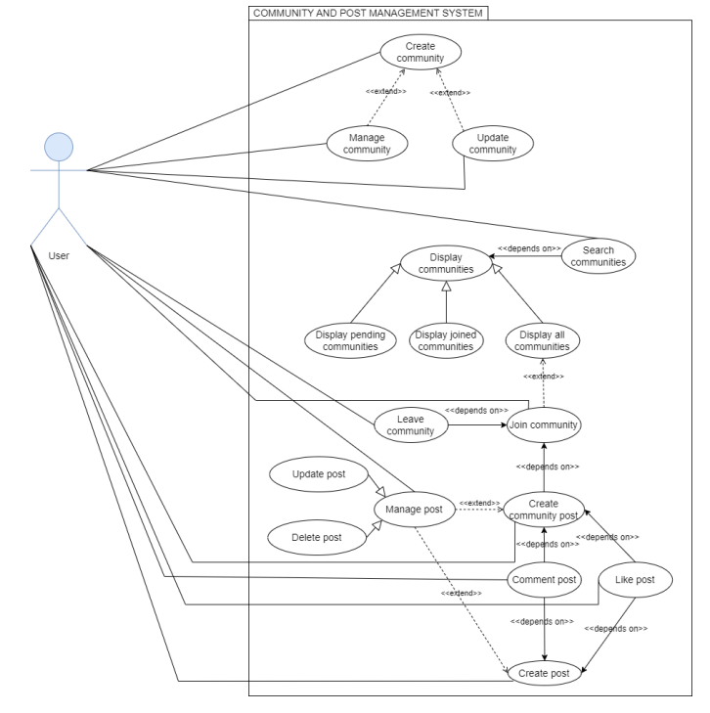
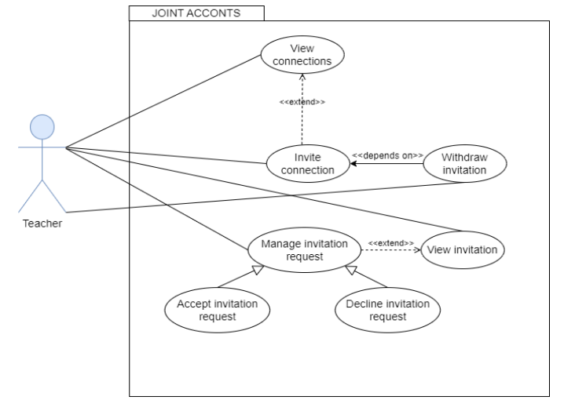
Cont…

Slide 28
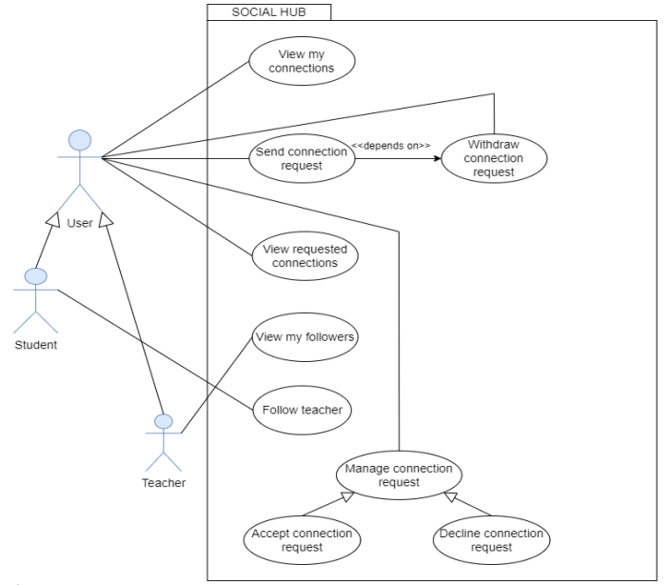
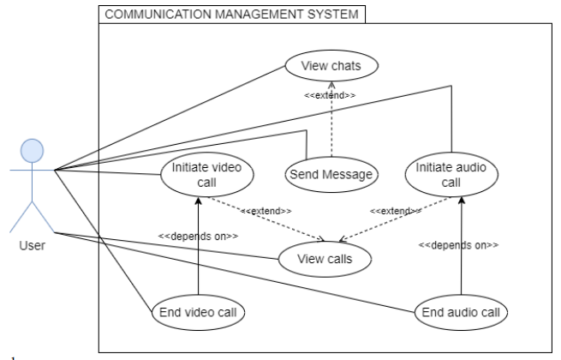
Cont…

Slide 29
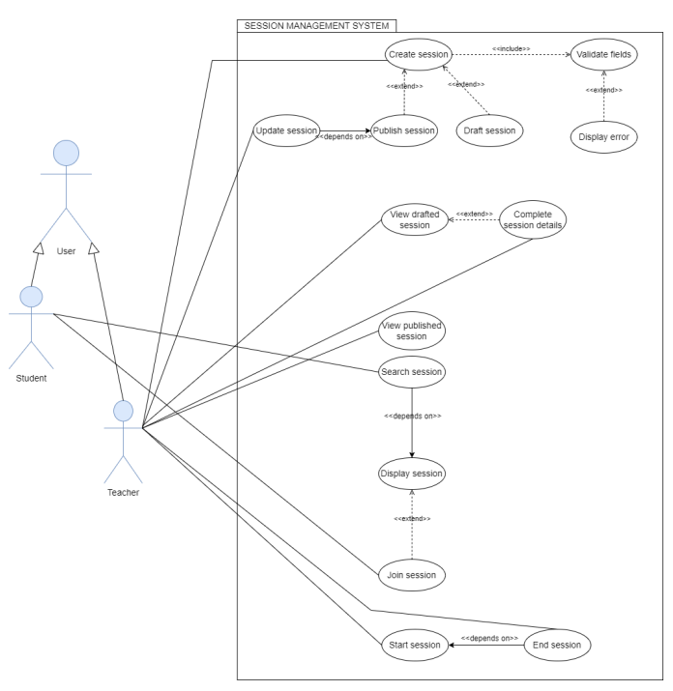
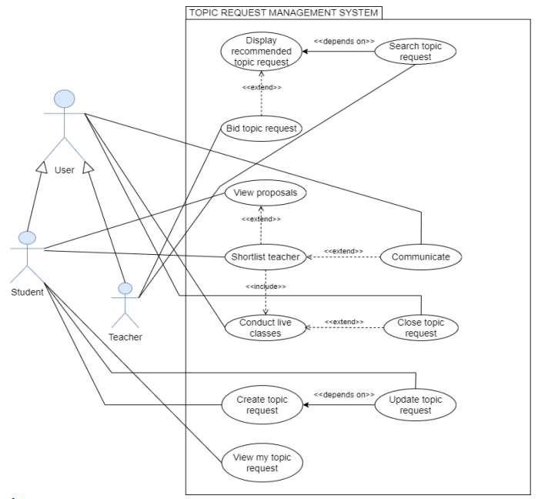
Cont…

Slide 30
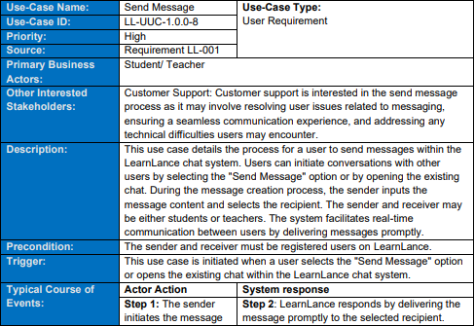
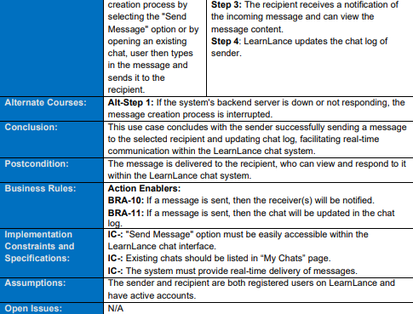
Use Case Narratives

Slide 31
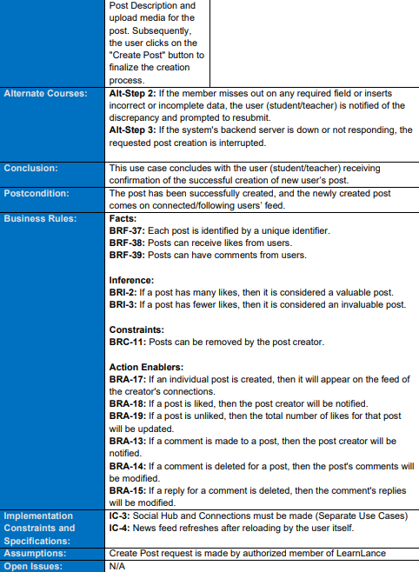
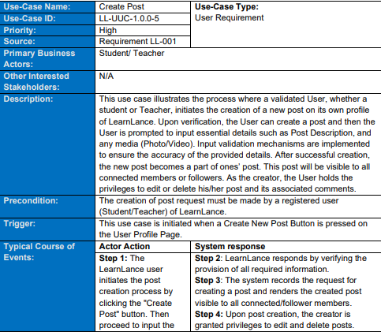
Cont…

Slide 32
NFR (EXTERNAL
QUALITY REQUIREMENTS)

Slide 33
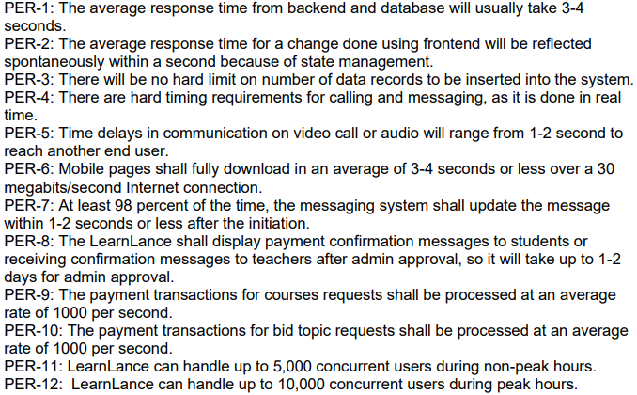
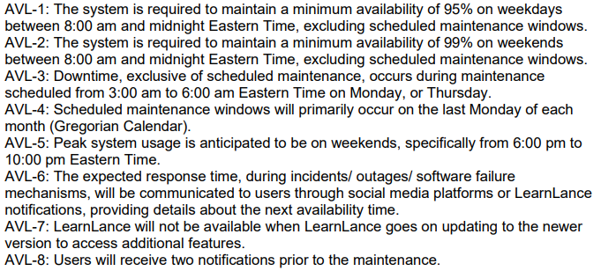
Performance
Availability

Slide 34
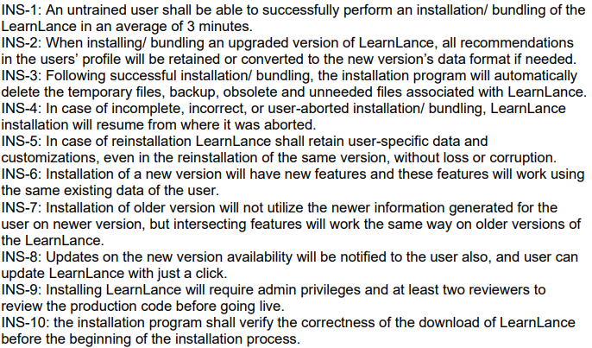
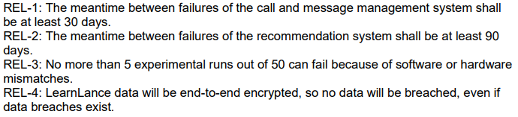
Installability
Reliability

Slide 35
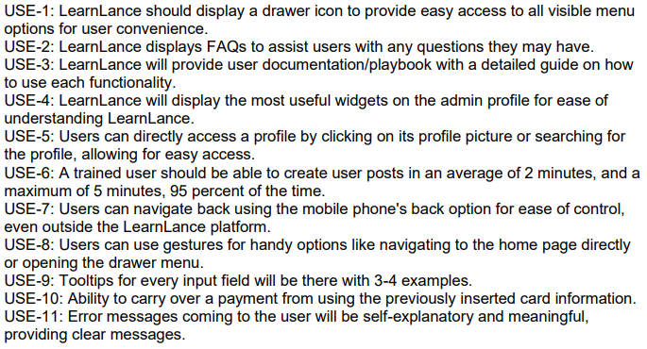
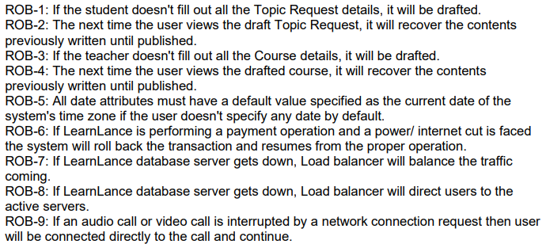
Usability
Robustness

Slide 36
NFR (INTERNAL
QUALITY REQUIREMENTS)

Slide 37
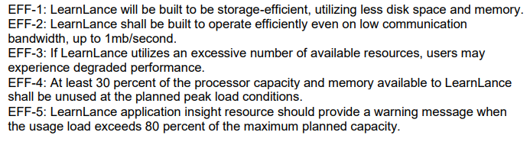
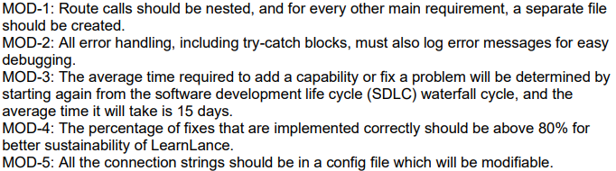
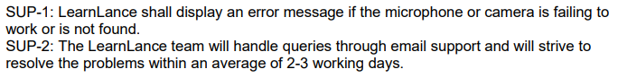
Efficiency
Modifiability
Supportability

Slide 38
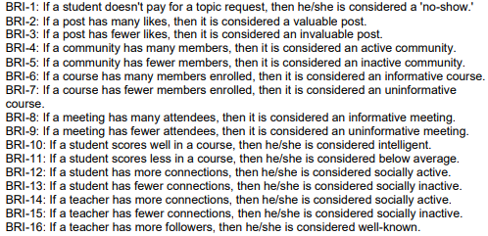
Inference
Business
Rules
For Constraint table, Business Rule Computation Table, Business Rule Catalog please refer to the SRS

Slide 39
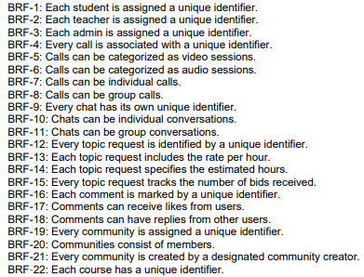
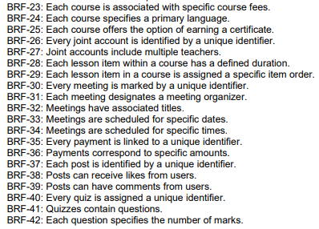
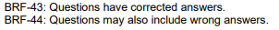
Facts

Slide 40


Constraints
Computations

Slide 41


Action Enablers

Slide 42

Decision Tree

Slide 43
ENITITIES
REPRESENTATIONS

Slide 44

ERD
Diagram

Slide 45

Swimlane

Slide 46







Data
Structures

Slide 47











Slide 48




Data
Dictionary

Slide 49



State Diagram

Slide 50



State Transition Matrices

Slide 51

CRUD
Matrix

Slide 52
REQUIREMENT
NEGOTIATION
AND
PRIORITIZATION

Slide 53

Requirement
Negotiation

Slide 54


User
Requirement
Prioritization
.
.
.

Slide 55


Functional
Requirement
Prioritization
.
.

Slide 56
THANK YOU

